Slide 1


Project Lambda
Deploying code to AWS

Slide 2
What is Project Lambda?
(Also, why are you making me do this?)
An opportunity to learn
A group project where everyone is learning something new.
An opportunity to teach
We’ll divide up the work and teach each other what we’ve learned.
An opportunity to collaborate
We’ll build something together and then give a demo to Analytics.
A way to shake things up a bit
This should be a fun diversion from the other projects we’ve been working on. :-)
✅
✅
✅
✅

Slide 3
Learning Concepts
Python - Process medical claims to create and return metrics
Concepts applied: Conditionals (if else), loops, list comprehension, Object Oriented Programming
Healthcare Concepts - Types of Billing (Institutional vs Professional), Types of Codes (Revenue vs Procedure vs Diagnosis)
Revenue codes are used on hospital bills to tell the payers (insurance companies) where the patient was when they received treatment (room and board).
Procedure codes (CPT codes) are used by healthcare providers to describe the services they provided to the insurance companies for payment.
Diagnosis codes (ICD-10 codes) describe the patient's medical condition and are required on claims submitted by healthcare professionals to the payers.
REST APIs - What are they and how can we interact with them?
JSON - Build a JSON structure for medical claims / Return a JSON structure with metrics
AWS (Lambda & API Gateway) - Set up a Lambda function and API Gateway in AWS

Slide 4
Retrospective
What went well?
Introduced and learned how to apply lots of new concepts (understand core Python concepts)
Enthusiasm to learn, experiment, and fail is still present months later
Challenges encountered
Applying new concepts take time. Was hard on myself on understanding them more quickly
Marathon, not sprint – consistency is key
Dedicated 30– 60 minutes every day to learning and apply concepts in code
Lots of reliance on Rich and Gary
Balance between working through problems independently and bringing in others with truly stuck

Slide 5
Project Goals
Collaboration
The first time we’ve all been able to work together on the same project!
Everyone contributes
Ideas, code, discussion, etc.
Everyone learns
New technologies, programming skills, health care concepts, etc.
A demo of our new proof of concept we can share with others

Slide 6
Project Overview
What will we do?
Build Python code that creates metrics from medical and pharmacy claims.
Deploy this code to a Lambda function.
Enable access through an API Gateway.
How will we do it?
We’ll dedicate time from the workday over the next 2 sprints to focus on this project.
We’ll divide up the work.
We’ll meet twice a week on Tuesdays (45m) and Thursdays (45m) and as needed in between.

Slide 7
Architecture

Slide 8
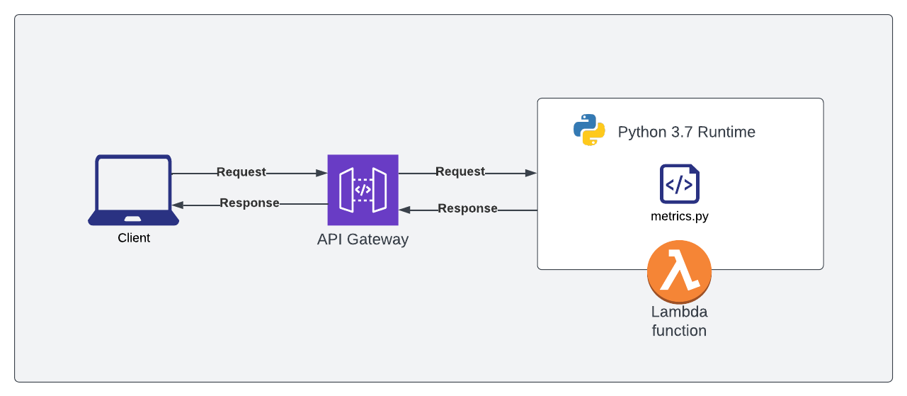
Design overview
Technology
API Gateway - Amazon API Gateway is a fully managed service that makes it easy for developers to create, publish, maintain, monitor, and secure APIs at any scale. APIs act as the "front door" for applications to access data, business logic, or functionality from your backend services.
Lambda Function - AWS Lambda is a serverless, event-driven compute service that lets you run code for virtually any type of application or backend service without provisioning or managing servers.
Terminology
Runtime describes software/instructions that are executed while your program is running, especially those instructions that you did not write explicitly, but are necessary for the proper execution of your code.
Request - HTTP defines a set of request methods to indicate the desired action to be performed for a given resource. (We will start with the POST method.)

Slide 9
Python metrics

Slide 10
Requirements for a metrics script
Accept and parse a JSON of medical and pharmacy claims data (1 or many members)
We should be prepared to process a single member or a batch of up to 500 members
This will require upfront design work
Calculate metrics
Everyone will choose a metric to code up in Python
Build and return a JSON response
This will require upfront design work

Slide 11
Choosing your metric
In general, you can pick any metric you’d like. Gary and I came up with a few that we think would be interesting and challenging.
Population & member-level status for LOS (Gary)
Population & member-level metric
Calculate the member’s Charlson Score
Member-level metric
Flag Admissions & Readmissions (Chien)
Member-level metric
Ambulatory Visit Counts (Rich)
Member-level metric

Slide 12
AWS

Slide 13
Building our architecture is easier than it sounds
Once we’re ready to test our code, we’ll:
Set up a Lambda function in AWS
Deploy our Python code
Create and configure an API Gateway to invoke our Lambda function
Implement access control (API Key) to prevent unauthorized access
Test our work

Slide 14
Demo
Notes:
curl -X GET https://ctxkde5661.execute-api.us-east-1.amazonaws.com/beta -H 'x-api-key: mcBkWftQ2p9s0Mhqf8Yni9EfdL8h2JX14HHUFGvJ'

Slide 15
Next steps
Notes:
curl -X GET https://ctxkde5661.execute-api.us-east-1.amazonaws.com/beta -H 'x-api-key: mcBkWftQ2p9s0Mhqf8Yni9EfdL8h2JX14HHUFGvJ'

Slide 16
Tentative timeline
Week 1
4/26 - Project kick-off / Choose and Research your metric
Bring a list of requirements (Exs: Diagnosis codes, CPT codes) to Thursday’s sync (4/28)
Grab time with Gary / Rich if you want to discuss
4/28 - Create claims JSON structure (working session)
Week 2
6/7 - Recap and next steps / Chien to build find_and() class method
6/9 - Work on individual metrics
Week 3
6/14 - Review our individual metrics
6/16 - Architecture build
Week 4
6/21 - Project Retrospective
6/23 - Demo! (optional)

Slide 17
Appendix
Notes:
curl -X GET https://ctxkde5661.execute-api.us-east-1.amazonaws.com/beta -H 'x-api-key: mcBkWftQ2p9s0Mhqf8Yni9EfdL8h2JX14HHUFGvJ'

Slide 18
Claims JSON
// JSON structure of a single member's claims
{
"member_id": "MEMBER123",
"member_age": 45,
"member_sex": "F",
"claims": [
{
"claim_id": "claim_x23123", // Internally generated
"claim_type": "I", // I: Institutional, P: Professional, R: Pharmacy(Rx)
"type_of_bill": "0111",
"admission_date": "2022-04-01",
"discharge_date": "2022-04-05",
"taxonomy_code": "A0001X35534",
"place_of_service": "21",
"diagnosis_codes": [
"A00.1",
"I29"
],
"claim_lines": [
{
"line_number": 1,
"revenue_code": "0250",
"procedure_code": "J2345",
"service_date": "2022-04-01",
"ndc_code": "",
"units": 0,
"allowed_amount": 155.50
},
{
"line_number": 2,
"revenue_code": "0251",
"procedure_code": "J2345",
"service_date": "2022-04-01",
"ndc_code": "",
"units": 0,
"allowed_amount": 1000.50
}
]
}
]
}

Slide 19
Processing Claims JSON
Loop through every member and call my function
Rich: Loop through every member and call my business logic
Chien: Loop through every member and call my business logic
Gary: Loop through every member and call my business logic
…
Loop through members 5x
Loop through every member and
call Rich’s business logic
call Chien’s business logic
call Gary’s business logic
…
Loop through members 1x
Loop through every member and
Separate claims by claim type
call Rich’s business logic
call Chien’s business logic
call Gary’s business logic
Reduce claims volume going to each fn()

Slide 20
Processing Claims JSON (helper functions)
claim type fn: Separating claims by claim_type
parameter: a member’s claims
returns: array of Professional claims; array of Institutional claims; array of Pharmacy claims
description: loops through claims and separates claims into 3 arrays based on claim_type [‘I’, ‘P’ ,’R’]
hospital inpatient fn: Filter hospital inpatient claims by type of bill code
parameter: Institutional claims (from above fn)
returns: array of Hospital Inpatient claims
description: loops through Institutional claims into 1 array based on type_of_bill in [‘011X’, ‘012X’]

Slide 21
Control Flow
Pass payload to Lambda
Pass all members to Claim Type function
Returns all members with claims categorized (institutional, professional, pharmacy)
Pass all members to Bill Type function
Pass payload to Lambda
Loop through members
Pass a member to Claim Type function
Returns all members with claims categorized (institutional, professional, pharmacy)
Pass a member to Bill Type function
Other options?
Hash table for every value in JSON
Chien
Gary
Abdul

Slide 22
Control Flow
// JSON structure of a single member's claims
{
"member_id": "MEMBER123",
"member_age": 45,
"member_sex": "F",
"claims": [
{
"claim_id": "claim_x23123",
"claim_type": "I",
"type_of_bill": "0111",
"admission_date": "2022-04-01",
"discharge_date": "2022-04-05",
"taxonomy_code": "A0001X35534",
"place_of_service": "21",
"diagnosis_codes": [
"A00.1",
"I29"
],
"claim_lines": [
{
"line_number": 1,
"revenue_code": "0250",
"procedure_code": "J2345",
"service_date": "2022-04-01",
"ndc_code": "3334445556",
"units": 0,
"allowed_amount": 155.50
}
]
}
]
}
KEY | Value
CONTENTS0MEMBER0MEMBER_ID | MEMBER123
CONTENTS0MEMBER0MEMBER_AGE | 45
CONTENTS0MEMBER0MEMBER_SEX | F
CONTENTS0MEMBER0CLAIM0LINE0PROCEDURE_CODE | 99214
CONTENTS0MEMBER0CLAIM0LINE0SERVICE_DATE | 04-01-2022
CONTENTS0MEMBER0CLAIM0LINE0NDC_CODE | 3334445556

Slide 23
Building a ‘Hash’ from JSON
Build an object from the JSON that can be easily traversed and queried
Unique keys for each JSON value; in a DICT[ionary] object
Naturally fast traversals with dictionaries in Python (as they are hashed).
{
"batch_id":"long_allyears",
"sequence":1,
"contents":[
{
"member_id":"mbr_002313701",
"member_age":48,
"member_sex":"F",
"claim":[
{
"claim_id":"clm_701224700",
"claim_type":"P",
"type_of_bill":null,
"admission_date":"2019-02-12",
"discharge_date":"2019-02-12",
"taxonomy_code":"363A00000X",
…
{
"batch_id":"long_allyears",
"sequence":1,
"contents.0.member_id":"mbr_002313701",
"contents.0.member_age":48,
"contents.0.member_sex":"F",
"contents.0.claim.0.claim_id":"clm_701224700",
"contents.0.claim.0.claim_type":"P",
"contents.0.claim.0.admission_date":"2019-02-12",
"contents.0.claim.0.discharge_date":"2019-02-12",
"contents.0.claim.0.taxonomy_code":"363A00000X",
"contents.0.claim.0.place_of_service":11,
"contents.0.claim.0.principle_diagnosis":"F909",
"contents.0.claim.0.diagnosis_codes.0":"F909",
"contents.0.claim.0.claim_line.0.line_number":1,
"contents.0.claim.0.claim_line.0.from_date":"2019-02-12",
"contents.0.claim.0.claim_line.0.thru_date":"2019-02-12",
…

Slide 24

JSON Hash function
Input parameter: dictionary (JSON)
Iterates through each key/value in
Identifies object type ( & hierarchy) -> dictionary, list, value
If dictionary or list then recurse
If list then enumerate the item position (0…n) which will be part of hash key
P_sparse - Rich’s secret sauce to keep this thing manageable with large JSON (removes null values)
def json_hash(p_dictionary, p_parent_key=False, p_sparse=False):
_items = []
for _key, _value in p_dictionary.items():
_new_key = str(p_parent_key) + '.' + _key if p_parent_key else _key
if isinstance(_value, MutableMapping):
# it's a dictionary
if not _value.items():
# check for empty dictionary
_items.append((_new_key, None))
else:
# not empty, recurse!
_items.extend(json_hash(_value, _new_key, p_sparse).items())
elif isinstance(_value, list):
# it's a list, so check to see if it's [not] empty
if len(_value):
for _k, _v in enumerate(_value):
_items.extend(json_hash({str(_k): _v}, _new_key, p_sparse).items())
else:
# empty list
_items.append((_new_key, None))
else:
# not dict or list, so append key, value
if p_sparse is True and _value is None:
continue
_items.append((_new_key, _value))
return dict(_items)

Slide 25
Ambulatory Visit Identification
PCP (Primary Care Provider) Visits
Limit to professional claims (claim_type = ‘P’)
Limit to place of service = ‘11’
Limit to claims with procedure codes in:
['99202', '99203','99204','99205','99201','99211','99212','99213',
'99214','99215','99327','99328','99334','99335','99336',
'99337','G0402','G0438','G0439']
Limit to Provider Taxonomy code in:
[‘207QA0000X’,’207QA0505X’,’207QG0300X’,’207RA0000X’,
’207RG0300X’,’207VG0400X’,’208D00000X’,’363LF0000X’]
Count distinct Date of Service
SPEC (Specialist) Visits
Limit to professional claims
Limit to place of service = ‘11’
Limit to claims with procedure codes in:
['99202','99203','99204','99205','99201','99211','99212','99213',
'99214','99215','99327','99328','99334','99335','99336',
'99337','G0402','G0438','G0439']
Limit to Provider Taxonomy code not in:
[‘207QA0000X’,’207QA0505X’,’207QG0300X’,’207RA0000X’,
’207RG0300X’,’207VG0400X’,’208D00000X’,’363LF0000X’]
Count distinct Date of Service
*Only distinction between PCP and SPEC is the inclusion vs. exclusion of the provider taxonomy codes.

Slide 26
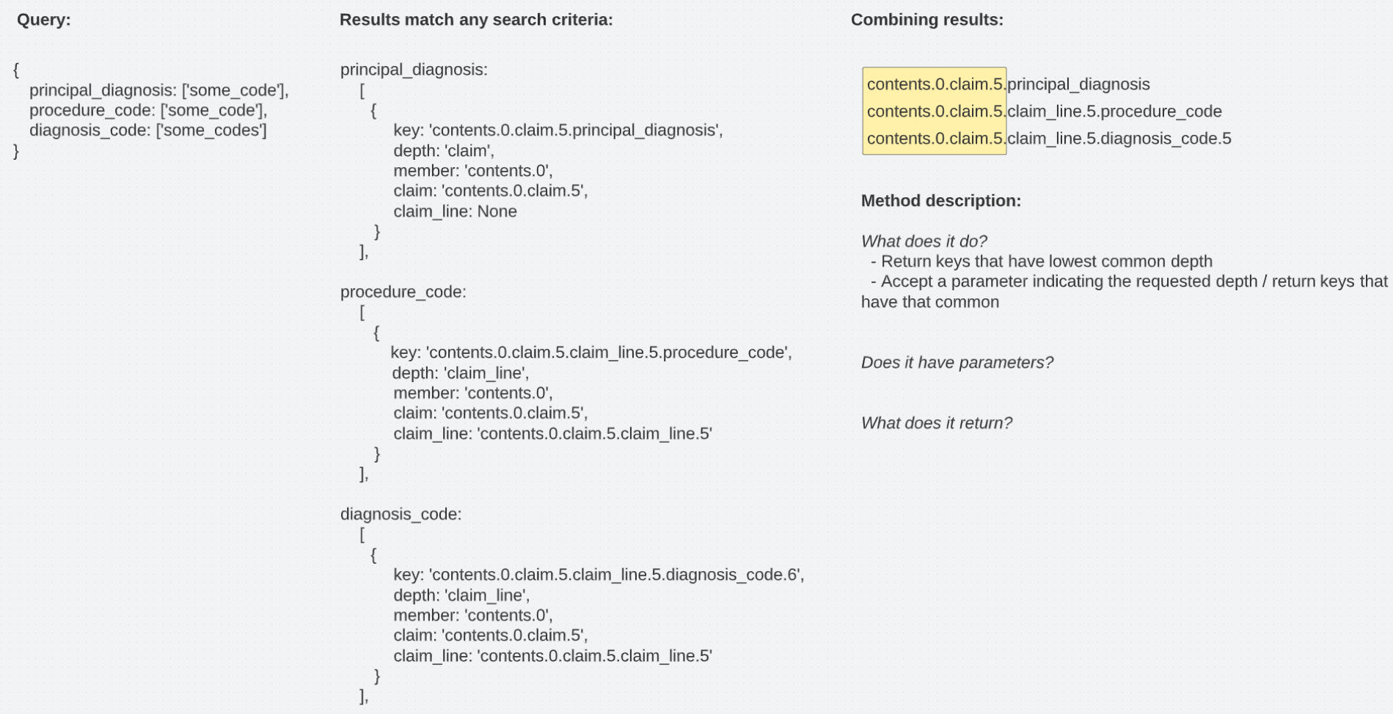
Class Methods
data.find_and({principal_diagnosis:[‘’], place_of_service: [‘11’]})
How does the method match keys?
- Matching on deepest common component of all keys
Does it have parameters?
- 1st: query
- 2nd: optional depth (member, claim, claim_line)
What does the method return?
- Depends on the parameters you pass it!
- Key component at the deepest possible level, or the level specified in the second parameter
xxx.find_and({search criteria}) -> ‘contents.0.claim.5.claim_line.5
xxx.find_and({search criteria}, ‘member’) -> ‘contents.0’
xxx.find_and({search criteria}, ‘claim’) -> ‘contents.0.claim.5’
What are you going to do with the results?
What information do you lose by returning the common element of all the keys?

Slide 27
How matching works
Do these match? - Yes
Do these match? - Yes (member only)
Do these match? - Yes
principal_diagnosis: [
{ key: ’contents.0.claim.5.principal_diagnosis'} ], procedure_code: [
{ key: 'contents.0.claim.5.claim_line.5.procedure_code.4'} ], diagnosis_code: [
{ key: 'contents.0.claim.5.claim_line.5.diagnosis_code.6'}],
principal_diagnosis: [
{ key: ’contents.0.claim.3.principal_diagnosis'} ], procedure_code: [
{ key: 'contents.0.claim.5.claim_line.5.procedure_code.4'} ], diagnosis_code: [
{ key: 'contents.0.claim.5.claim_line.5.diagnosis_code.6'} ],
principal_diagnosis: [
{ key: ’contents.0.claim.5.principal_diagnosis'},
{ key: ’contents.1.claim.5.principal_diagnosis'} ], procedure_code: [
{ key: 'contents.0.claim.5.claim_line.5.procedure_code.4'},
{ key: 'contents.1.claim.5.claim_line.5.procedure_code.2'} ], diagnosis_code: [
{ key: 'contents.0.claim.5.claim_line.5.diagnosis_code.6'},
{ key: 'contents.1.claim.5.claim_line.5.diagnosis_code.6'} ],
Why?
Questions?
Why?
Matches on member and claim
Do we allow to match at various levels?
What do we return?
Because we match across the search criteria
What do we return?
What do we return?
What do we return?
[contents.0,
contents.0.claim.5]
[contents.0]
[contents.0,
contents.1,
contents.0.claim.5,
contents.1.claim.5]
Next Steps: 1. Define how to match keys at different levels // 2. Define the return object (structure and contents)

Slide 28
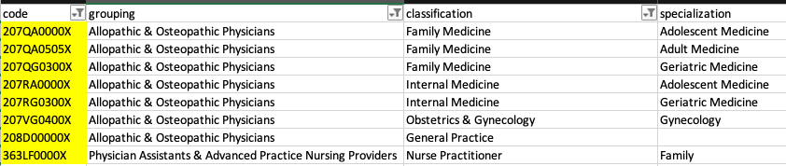
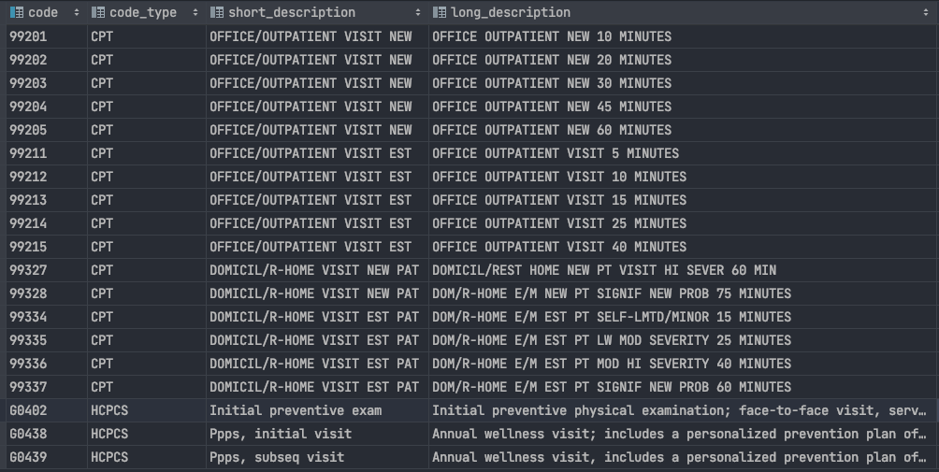
Ambulatory Visit Identification (cont.)
Provider Taxonomy Codes: Procedure Codes:

Slide 29
Length of Stay
Indicator Importance:
Quality measure of efficiency for inpatient facility
Measures:
Length of Stay (LOS): Member inpatient claim
Average LOS (ALOS): Arithmetic mean of LOS for patient population
Geometric Mean LOS (GMLOS): Geometric mean of LOS for patient population
Median LOS (MLOS): Median LOS for patient population
Assumptions:
Inpatient setting
Room & Board rev code
Include only stays of 1 day or more, with cap at 365 days
No Diagnosis/DRG categorization due to small sample size
No date exclusions
Criteria:
claimtype = ‘I’ (institutional)
typeofbill = ‘^1[12].&’
revenuecode = ‘^1.’
length of stay = discharge_date - admission_date (> 0)

Slide 30
Length of Stay (cont)
Calculations:
Returned JSON structure / payload:
{
“measure_title”, “length of stay”,
“date”, “2022-05-03”,
“measure_payload”,
{
“Group”,
[
{
“measure”, “ALOS”,
“value”, 6.7,
},
{
“measure”, “GMLOS”,
“value”, 6.2,
},
…
],
“Member”,
[
{
},
]
}
}

Slide 31
Identifying Inpatient Admission Event
Step 1: Limit to Institutional claims using claim_type = ‘I’
Step 2: Limit type_of_bill = 011X or 012X
Logic: Second 1 indicates hospital; Third indicates Inpatient Part A (1) or Part B (2)
Step 3 : Limit to claims with UB revenue codes for inpatient services (e.g. 0100 - 0219, 1000 - 1009)
In CDW: SELECT code FROM reference.revenue_code_dim WHERE sub_type = 'Accommodation Codes';
Step 4: Exclude discharge status code not in: ['07'] -
Step 5: Count distinct discharge_date at the claims header level

Slide 32
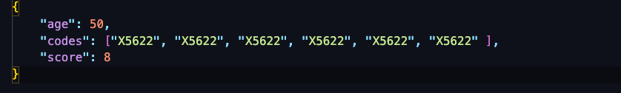
Charlson Comorbidity Index (CCI)
I did not put much thought into it and will come back ASAP.

